Slide 1
UNIGO

Slide 2
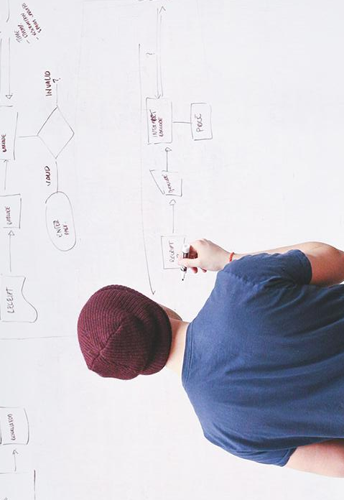
HELLO!
We are
Team - Bit Ends
Team Leader – Nishant Kumar sahu
Team Member – Piyush Kumar
Bhilai institute of technology , Durg

Slide 3
OUR IDEA
Let’s Get Started

Slide 4
BIG CONCEPT
Heard of google Local guides? How they contribute to google maps about various places, and millions of people rely on their contributions to decide where to go and what to do. Similarly, we wish to create a platform for developing a community of local helpers who are concerned about the environment and take initiative to improve changing climatic conditions.

Slide 5
Features
The local helpers can :
Post photos and description of the various initiatives they have taken (like planting trees, posting photos of polluted ponds or factories causing air pollution)
For helpful posts they will earn reward points

Slide 6
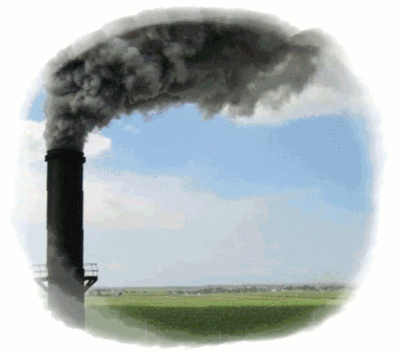

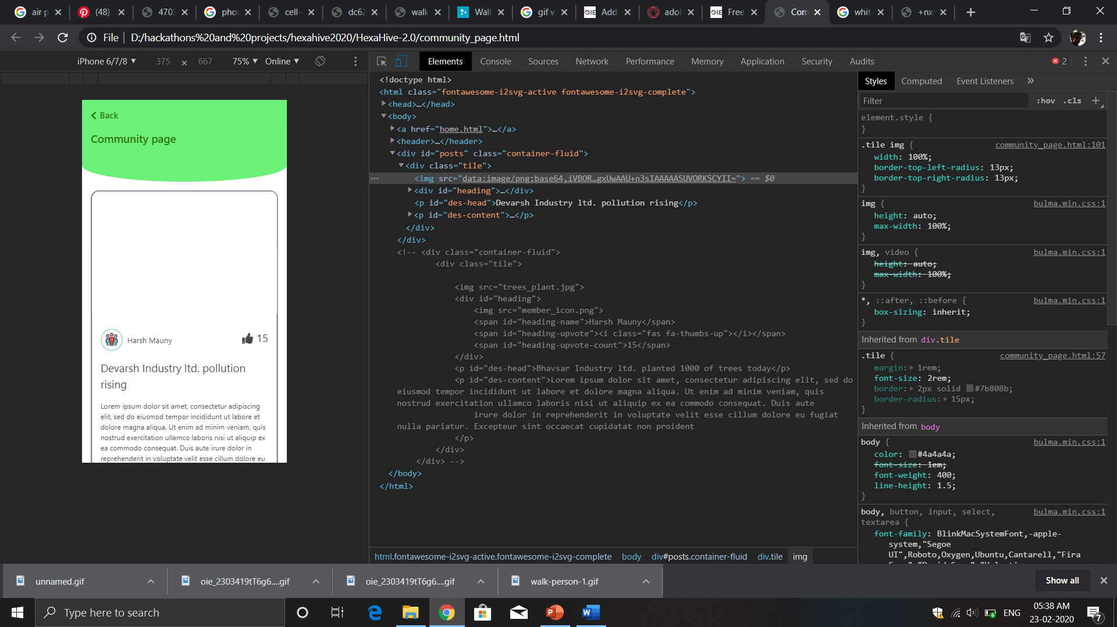
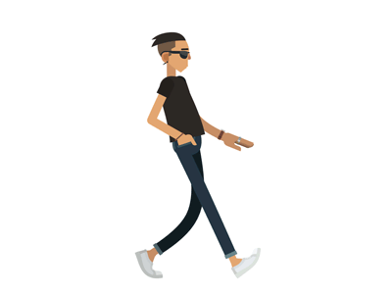

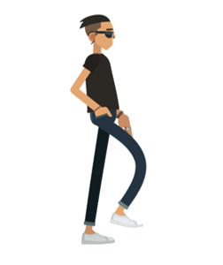

Slide 7
TECHNOLOGY STACK
FRONT-END
HTML 5
CSS (Bulma Framework)
JavaScript
jQuery
AJAX
BACK-END
Block-Chain
Meta Mask
Ganache
Custom made API (Python)

Slide 8
Why we’re using Block-Chain?
TRANSPARENT
Everyone will be having the same authority / access to the app.
DECENTRALIZED
No organization or person has central control over the platform.
IMMUTABLE
Due to immutable nature of the platform, frauds can be prevented.

Slide 9
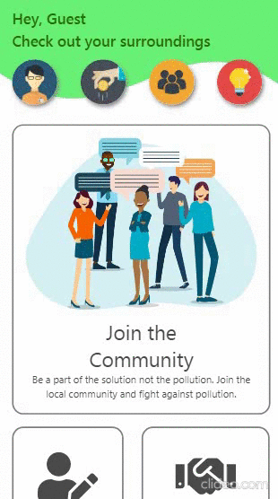
Home Page
The user can navigate to various features from this page like join the community, check the community page
Place your screenshot here

Slide 10
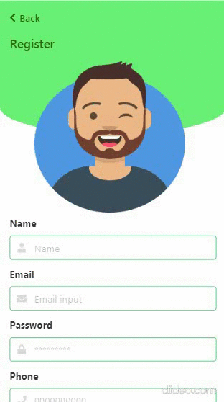
Register Page
The user can register to the community by providing the following details
Place your screenshot here

Slide 11
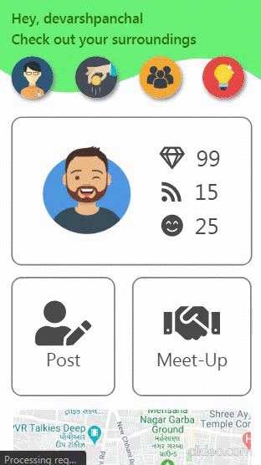
Post Page
The community member can post images and description which will be displayed on community page.
Place your screenshot here

Slide 12
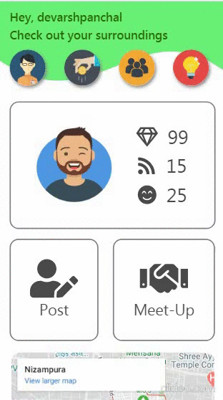
Community Page
All the verified posts posted by the user will be visible here,
Other members can either update the posts or flag the post if it doesn’t seem valid
Place your screenshot here

Slide 13
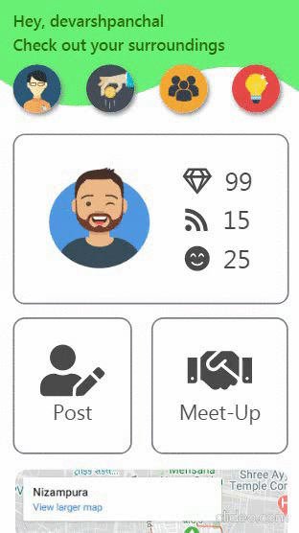
Donations page
The users can donate amount as per there will to the community.
Place your screenshot here

Slide 14

Logged in User Page
Once the user is registered, the following interface would be visible.

Slide 15
THANKS!

